Slide 1
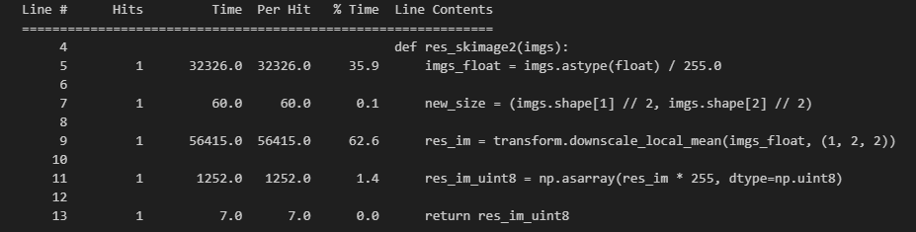
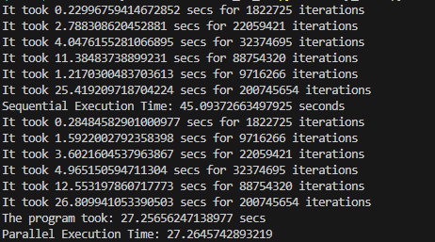

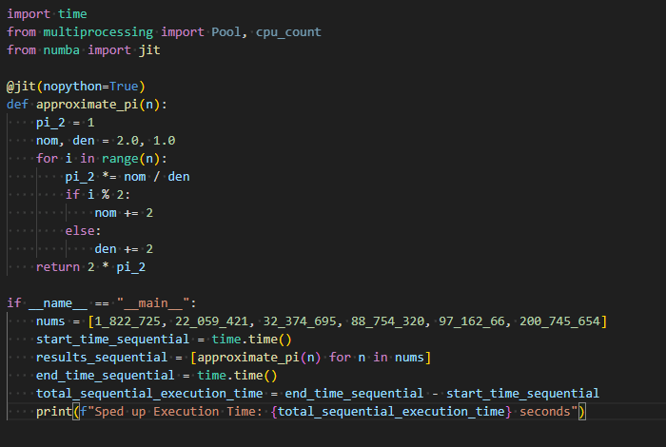
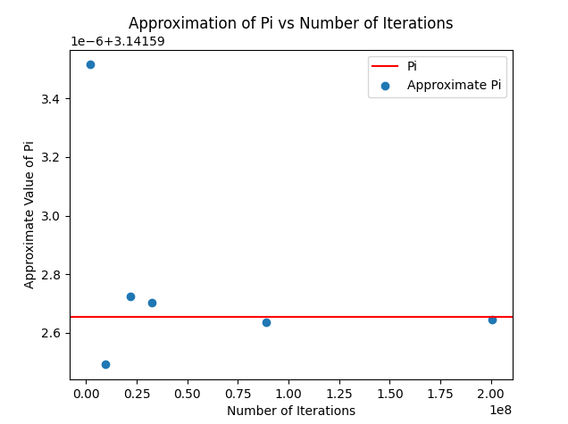
Task 1
Task 2
This was the bottleneck point in the code. I altered the code to convert it into float data type and am performing a transform.downscale_local_mean() operation. This is a functionality of the skimage.transform. It reducing the spatial resolution of an image while preserving local mean information
I have implemented multiprocessing as this task can readily be divided into multiple processes without an hassle. Avoiding the Global Interpreter Lock in such CPU-bound scenario also played a role in using multiprocessing over multithreading. Parallel execution sped up the task by around 45%.
Task 3
Task 4
By using @jit(nopython=True), the code sped up from 45.1 seconds to 1.6 seconds which is a major boost.
Alap Mundayoor, M.N. 23351429, IdM: ow07ysym

